Slide 1
Learning Hacking? First learn how to hide... Enhance your Anonymity Online with Tor, Proxychains & MacChanger!
DLarisa

Slide 2
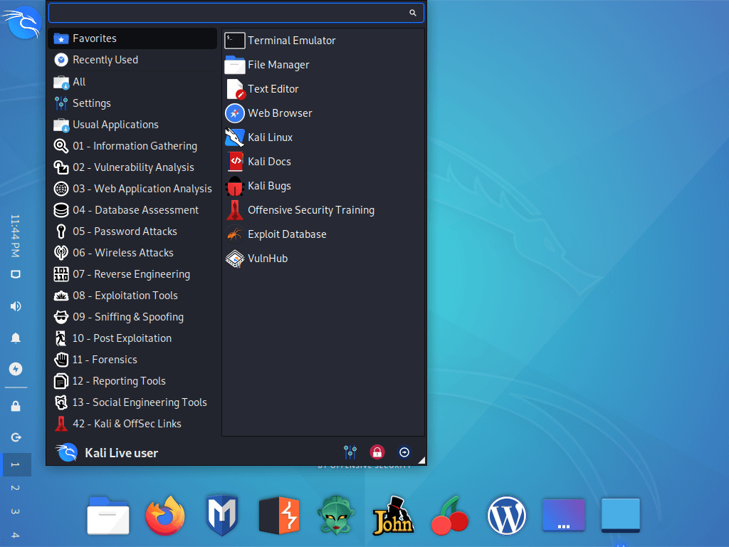

Kali Linux

Slide 3
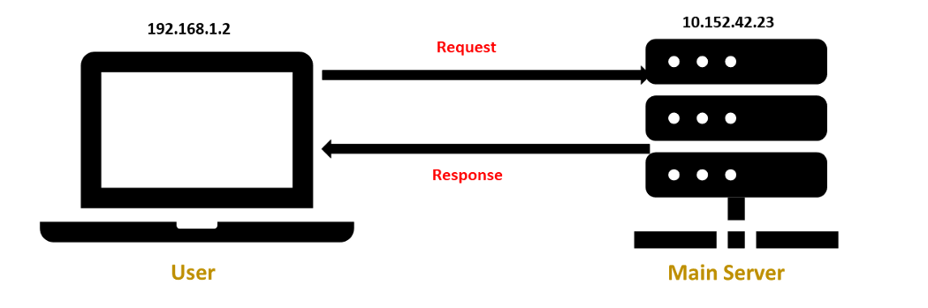
Server Request

Slide 4


Slide 5
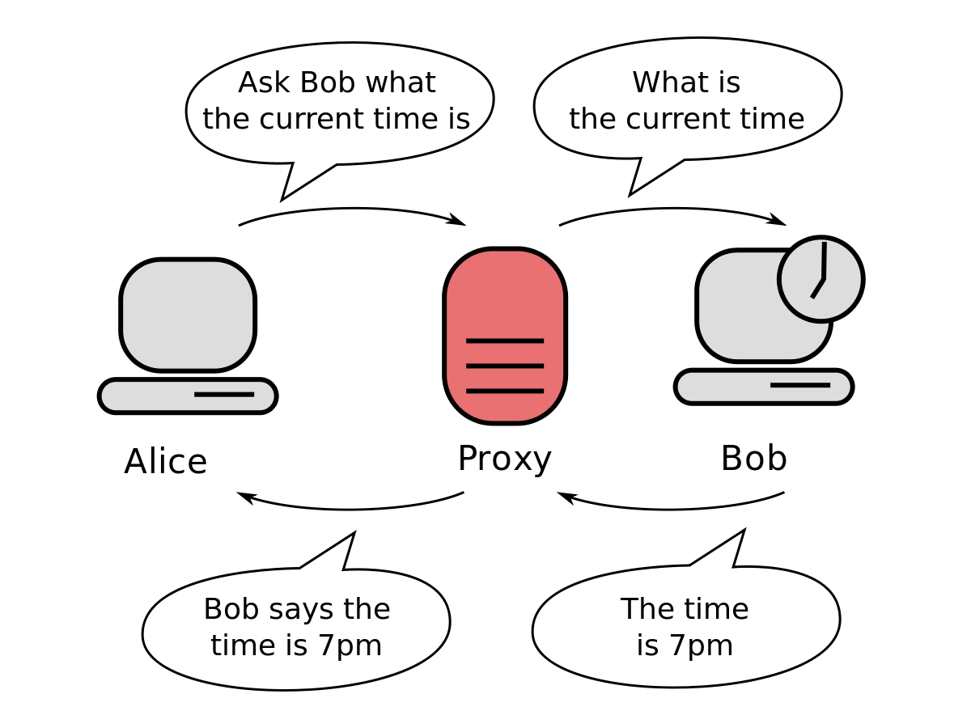
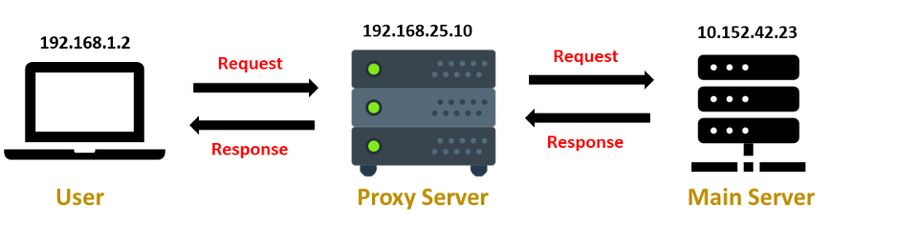
Proxy

Slide 6
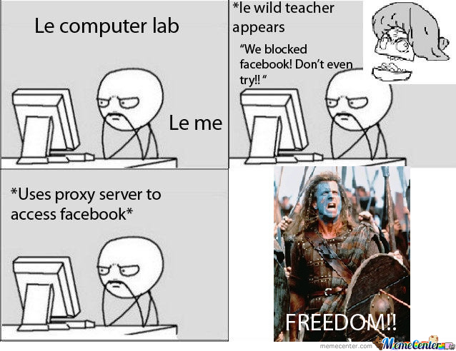

Slide 7
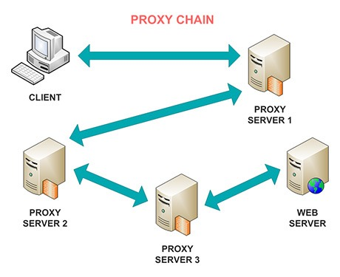

proxychains

Slide 8
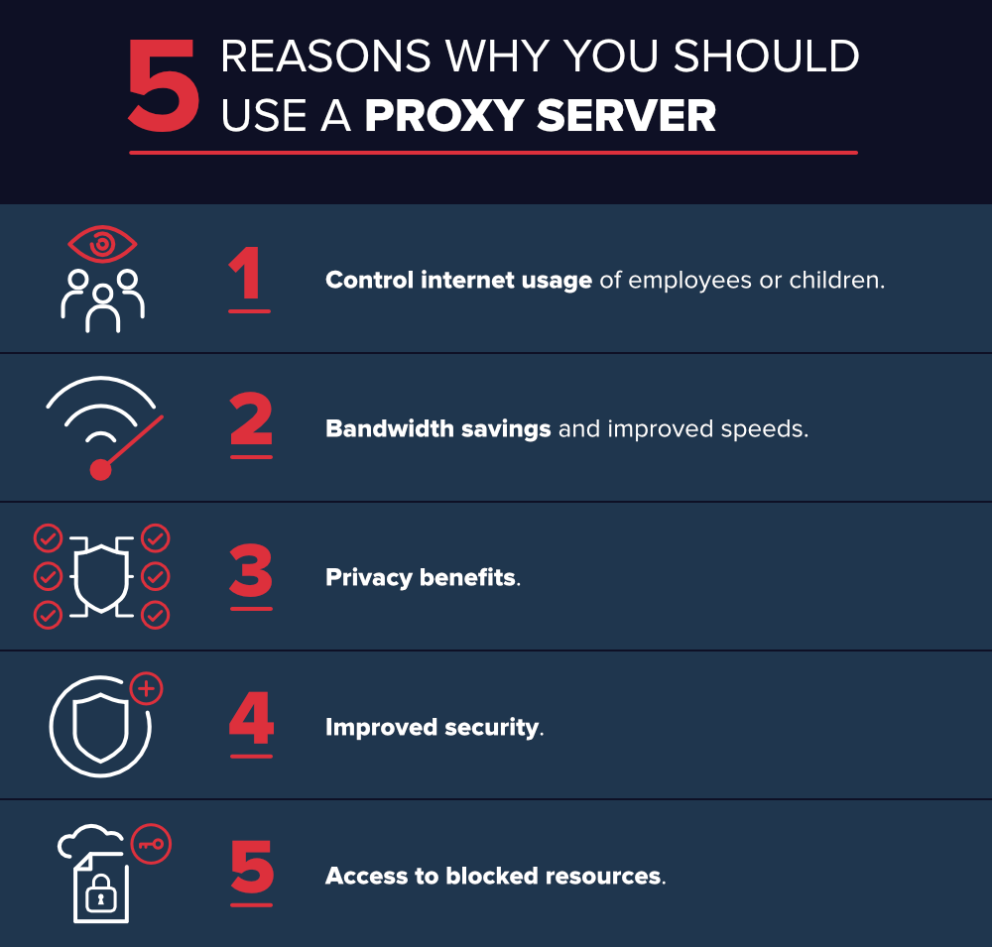
Benefits of proxy servers

Slide 9
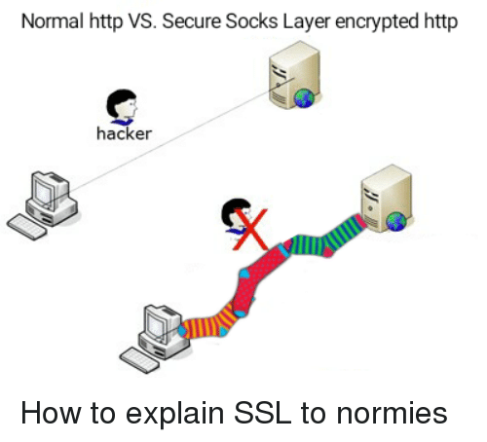
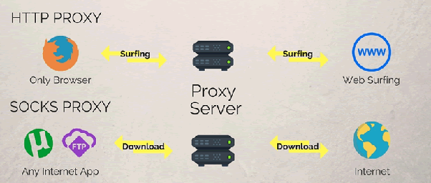
http vs socks

Slide 10



TOR

Slide 11

Remember...

Slide 12
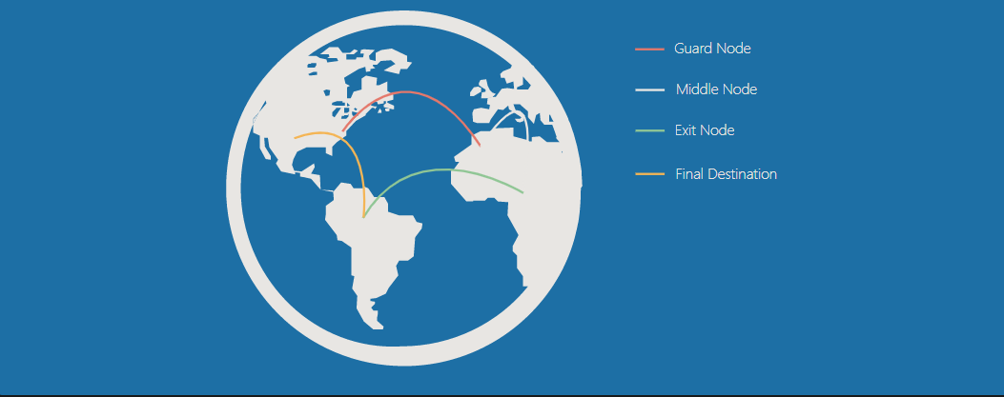
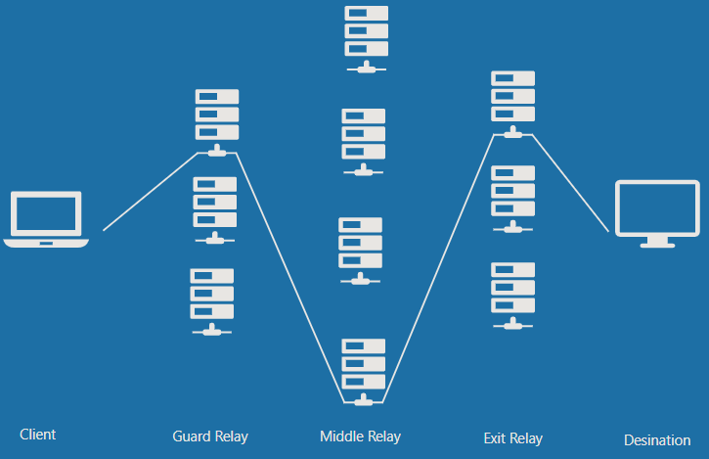
Nodes / Relays

Slide 13

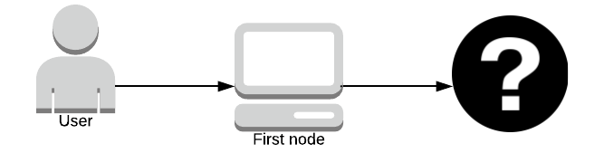

Rules for relays

Slide 14
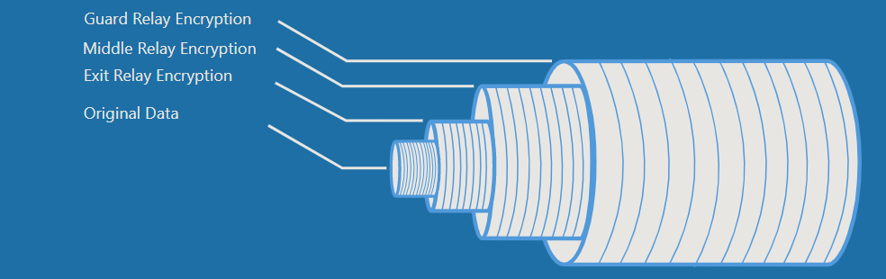
Encryption in tor network
The client encrypts the original data in such a way that only the exit relay can decrypt it.
This encrypted data is then encrypted again in such a way that only the middle relay can decrypt it.
Finally, this encrypted data is encrypted once more in such a way that only the guard relay can decrypt it.

Slide 15
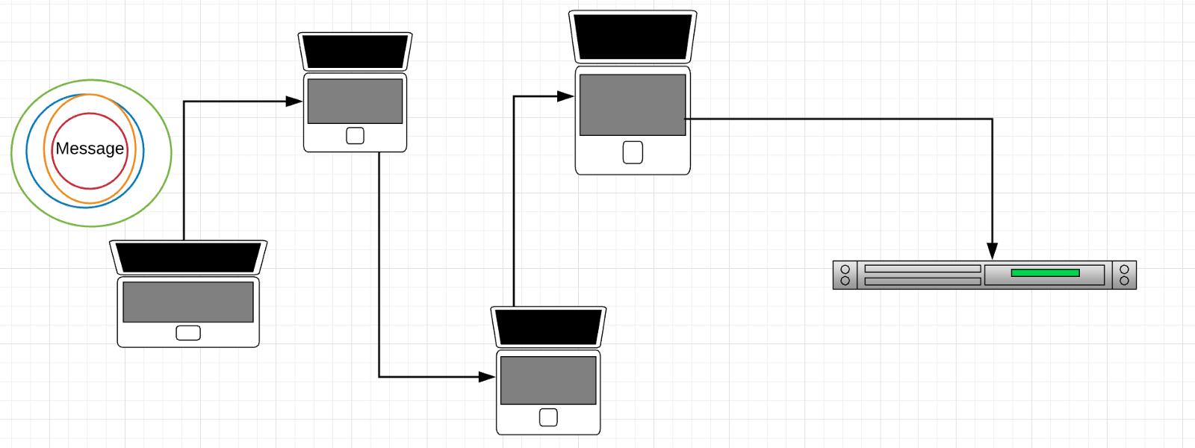
The journey of the message

Slide 16
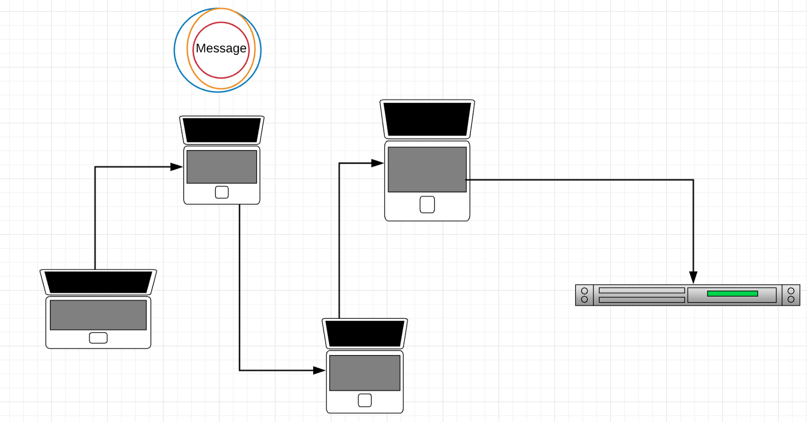
The journey of the message

Slide 17
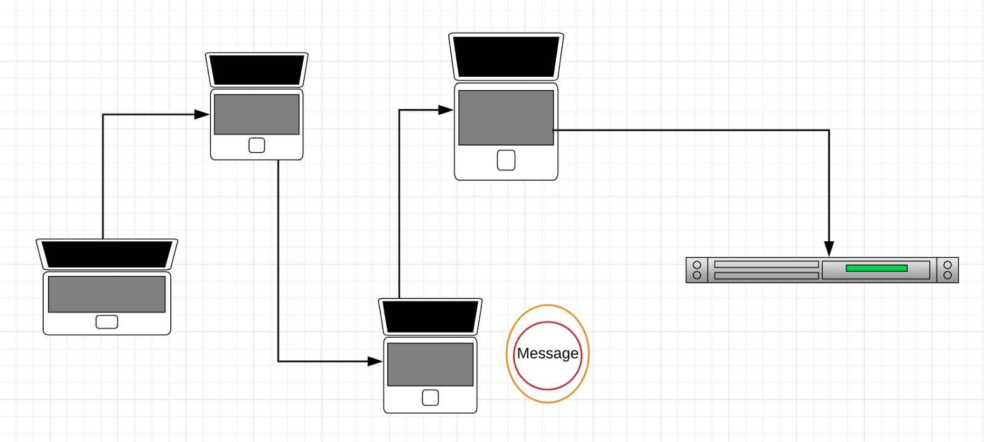
The journey of the message

Slide 18
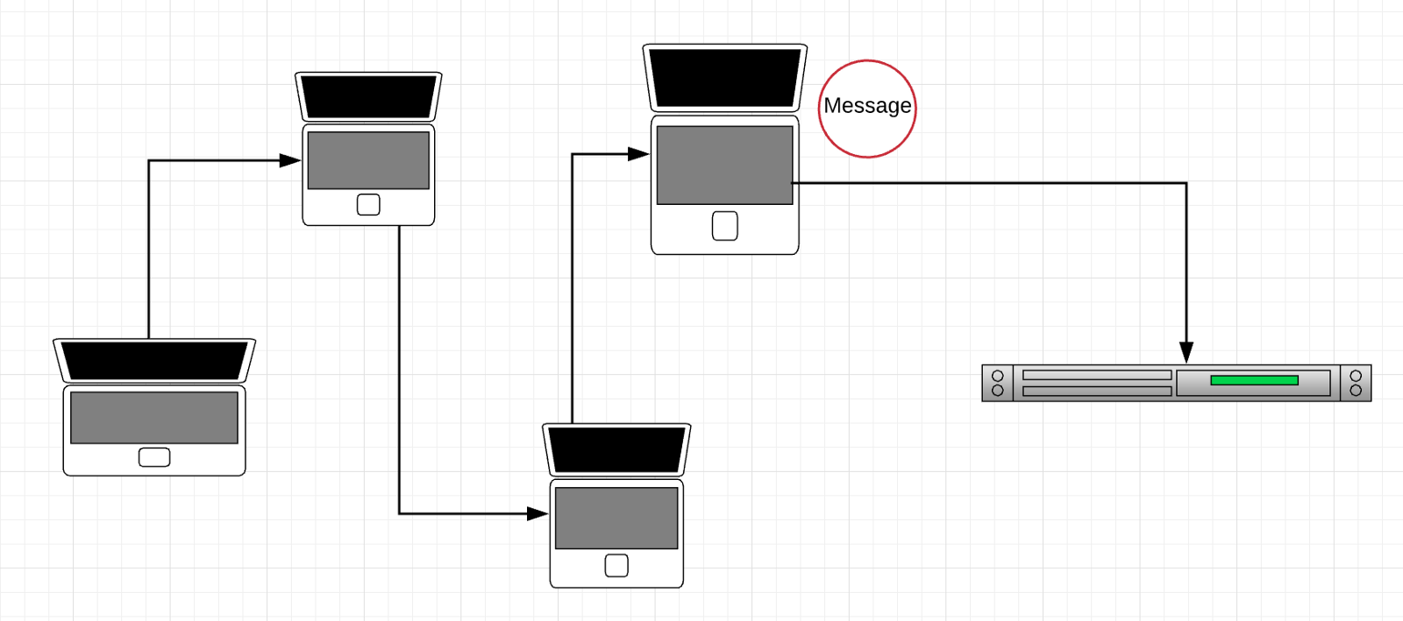
The journey of the message

Slide 19
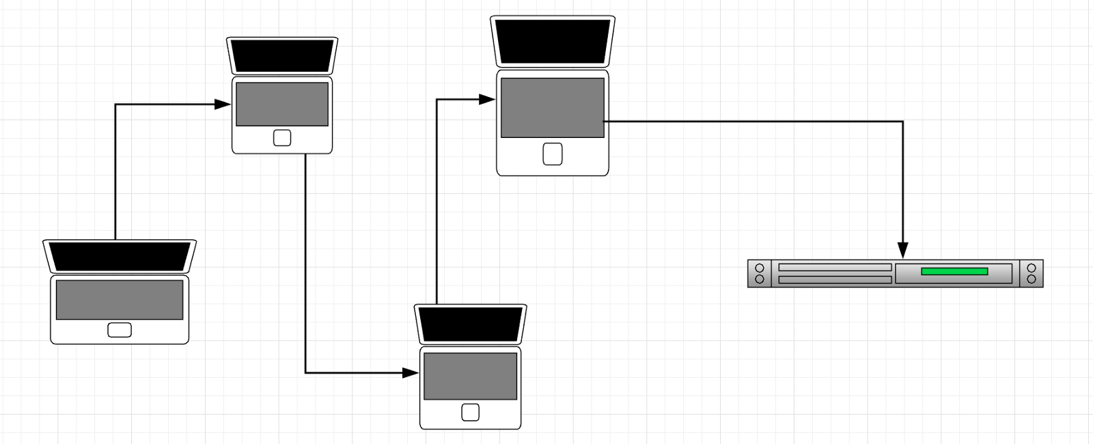
The journey of the message
Message

Slide 20
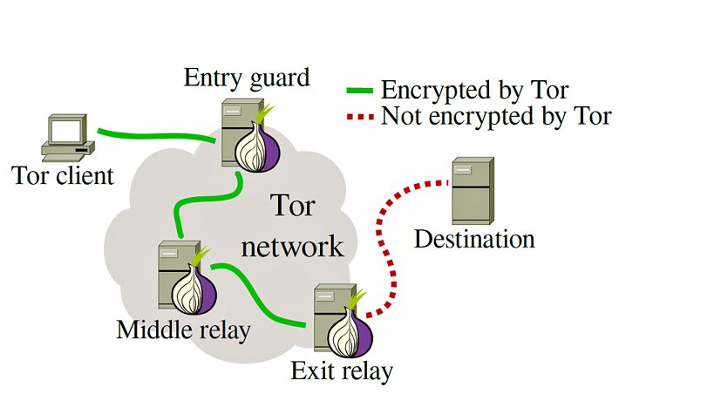
One vulnerability

Slide 21

How to protect yourself from malicious exit nodes
1. Only browse with HTTPS
2. Keep your sensitive information to a minimum
3. Only consume .onion sites as they don’t require leaving through an exit node
4. Encrypt your data
5. Use a VPN for the exit node
Kali Linux

Slide 22
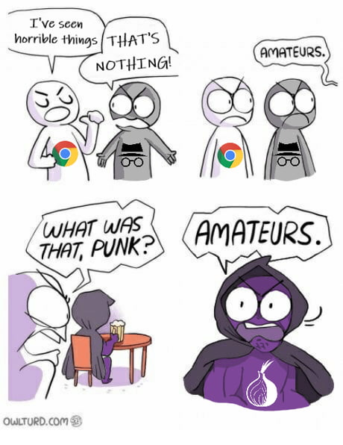

Slide 23
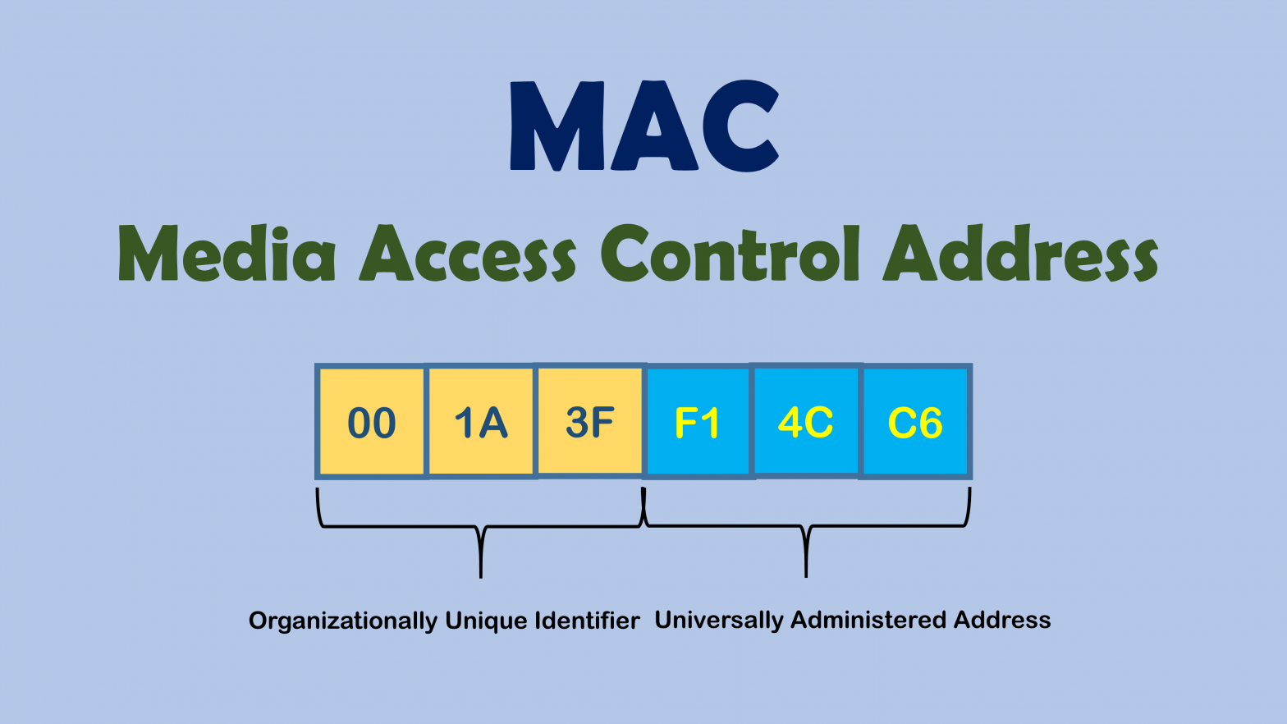

Mac address

Slide 24
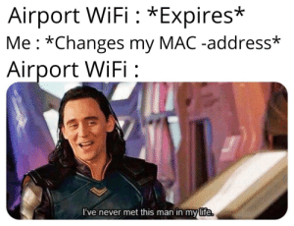
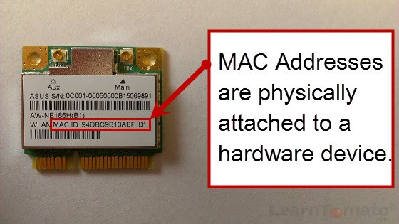
macchanger

Slide 25

Thank you for your attention!

Slide 26
Sources of photos
https://www.edureka.co/blog/proxychains-anonsurf-macchanger-ethical-hacking/
https://thecybersecurityman.com/2018/08/08/pentest-edition-evade-detection-using-tor-and-proxy-chains/
https://en.wikipedia.org/wiki/Proxy_server
https://www.varonis.com/blog/what-is-a-proxy-server/
https://ro.outletshop2021.ru/content?c=socks%20vs%20http%20proxy&id=10
https://www.kwtrain.com/blog/the-onion-router
https://medium.com/@codeprincess/all-in-one-functions-proxies-eb960a64115d
https://pics.me.me/normal-http-vs-secure-socks-layer-encrypted-http-hacker-how-29227043.png
https://memegenerator.net/img/instances/72667271.jpg
https://jordan-wright.com/blog/2015/02/28/how-tor-works-part-one/
https://i.pinimg.com/originals/e4/ab/61/e4ab61bf461adc000e20055841cb7fde.jpg
https://img-9gag-fun.9cache.com/photo/ad5B7Wj_460s.jpg
https://memegenerator.net/img/instances/55564565.jpg
https://pics.me.me/thumb_airport-wifi-expires-me-changes-my-mac-address-airport-wifi-56785626.png

